Slide 1

Team Assignment 01

Slide 2

Contents
1
Use-Case
2
The Architectural Driver
3
Project Scope

Slide 3
Introduction
Gives an overview of the business context and the architectural drivers with their impact on the project.
Contains the project deliverables, the summary of the schedule
Show the development strategy that we choose to show how this may affect the design of a system.

Slide 4
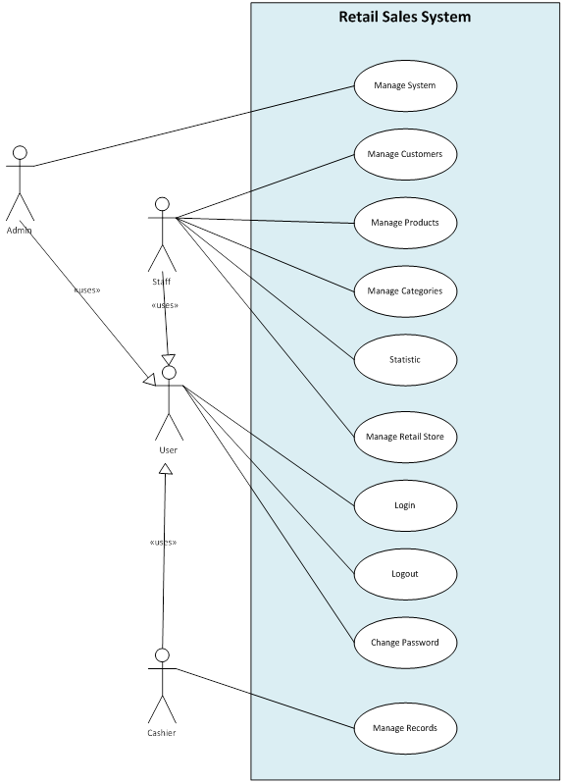
Use Case

Slide 5
Ranking Use-case
Use Case ID | Use Case Name | Important Level | Difficulty Level
System Management
UC_SM01 | Add New User | High | Medium
UC_SM02 | Search/ View User List | Medium | Low
UC_SM03 | View User Log | Low | High
UC_SM04 | View User Detail Information | Normal | Low
UC_SM05 | Assign Authorize | High | High
UC_SM06 | Update User Information | Normal | Medium
UC_SM07 | Sync Information | High | High
Product Management
UC_PM01 | Add New Product | High | Medium
UC_PM02 | Search/ View Product List | Medium | Low
UC_PM03 | View Product Detail Information | Medium | Low
UC_PM04 | Choose Category | Medium | Low
UC_PM05 | Update Product Information | Medium | Medium

Slide 6
Ranking Use-case
Record Management
UC_RM01 | Add New Record | High | High
UC_RM02 | Search/ View Record List | Medium | Low
UC_RM03 | View Record Detail Information | Medium | Low
UC_RM04 | Print Record | Medium | Medium
Retail Stores Management
UC_RSM01 | Add New Store | High | Medium
UC_RSM02 | Search/ View Store List | Medium | Low
UC_RSM03 | View Store Detail Information | Medium | Low
UC_RSM04 | Update Store Information | Medium | Medium

Slide 7
Ranking Use-case
Category Management
UC_CM01 | Add New Category | High | Medium
UC_CM02 | Search/ View Category List | Medium | Low
UC_CM03 | View Category Detail Information | Medium | Low
UC_CM04 | Update Category Information | Medium | Medium
Customer Management
UC_C01 | Add New Customer | High | Medium
UC_C02 | Search/ View Customer List | Medium | Low
UC_C03 | View Customer Detail Information | Medium | Low
UC_C04 | Update Customer Information | Medium | Medium
UC_C05 | View Customer Point Log | High | Medium
UC_S01 | Statistic Information | Low | High

Slide 8
Use-case Description
Use Case Title: Add New Store | Use Case ID: UC_RSM01
General Use Case Description: This use case help the manager add new sale store. This function can also split products of retail stores that are consumed, as well as regulate the product price.
Entities Involved: Staff, Retail Store
Preconditions: User is assigned authorized to use this function User has chosen Retail Stores Management function The system is available
Primary Use Case Flow of Events: User choose “Add new store” button Program displays Add new store interface User fills in Store name text field User fills in Address text field User chooses a Category Program displays Products which has in that Category User chooses a Product Program add the product which user just has chosen to the Product List with the standard Price User can edit the Price base on how much the store want to sell that product. User clicks "OK". Program shows message "Are you sure you want to create new retail store’s information as above?" User clicks "OK" to confirm The system stores the retail store’s information that has just been created and returned to retail store management interface End Use-case

Slide 9
Use-case Description
Primary Use Case Post Conditions: Successful: Create new successful. The system stores the retail store’s information that has just been created and returned to retail store management interface Fail: Failed to create new
Alternate Use Case #1 Flow of Events: There is a store with already name (starting from step 11 of the main flow) Program shows message "Are you sure you want to create new retail store’s information as above?" User clicks "OK" to confirm Program check in database and found that it has a store with already name Program display warning dialog “There is a store with already name. Please fill in again” End Use-case
Alternate Use Case #1 Post Events:

Slide 10
Use-case Description
Use Case Title: Sync Information | Use Case ID: UC_SM01
General Use Case Description: This use case help the administrator synchronize information between retail stores and head office: mostly customer’s points needs to be updated to be able to use immediately the next day
Entities Involved: Administrator
Preconditions: User use this function at the end of the day when all sessions are finished The system is available
Primary Use Case Flow of Events: User choose “Sync Information” button Program displays Sync Information interface User choose the retail store want to sync with the head office User choose type what to sync: all or just customer point User choose “Sync” button Program syncs information between the head office with those retail stores Program shows message “Sync Information Successful” End Use-case

Slide 11
Use-case Description
Primary Use Case Post Conditions: Successful: Sync Successful Fail: Failed to sync OK
Alternate Use Case #1 Flow of Events: Can’t access the retail store’s database (starting from step 6 of the main flow) Program syncs information between the head office with those retail stores Program shows message “Sync Information Successful” End Use-case
Alternate Use Case #1 Post Events:

Slide 12
Use-case Description
Use Case Title: Add New Record | Use Case ID: UC_RM01
General Use Case Description: This use case helps cashiers who work at retail stores make bill-paying for customers. Cashier can use barcode reader or directly enter the product code and product number by keyboard, then use the payment function to save to database and printed out bills for customers.
Entities Involved: Cashier, Retail Store
Preconditions: User is assigned authorized to use this function User has chosen Record Management function The system is available.
Primary Use Case Flow of Events: User choose “Add new record” button Program displays Add new store interface User fills in Bar Code text field User choose “Add” button The system load information from database to the “Product List” table on the interface. User fills in Quantity text field User clicks "Pay Bill". The system stores the record’s information that has just been created and prints the bill. Then the program returns to record management interface End Use-case

Slide 13
Use-case Description
Primary Use Case Post Conditions: Successful: Sync Successful Fail: Failed to sync OK
Alternate Use Case #1 Flow of Events: Can’t access the retail store’s database (starting from step 6 of the main flow) Program syncs information between the head office with those retail stores Program shows message “Sync Information Successful” End Use-case
Alternate Use Case #1 Post Events:

Slide 14
Business Constraints
Consideration | ID | Business Constraints.
Cost limitations. | BC01 | None
Schedule limitations. | BC02 | 6 weeks
Mandatory regulatory restrictions and demands. | BC02 | Customer who have become point service members are issued point cards. Points can be used in all stores. The member the either pays with cash, points, or a combination of the two
Legal restrictions and demands. | BC03 | None
Market restrictions and demands. | BC04 | The actual retail price must be set in advance.
Organizational restrictions and demands. | BC05 | One team with 6 members
Logistical issues. | BC06 | None

Slide 15
Technical Constraints
Consideration. | ID | Technical Constraints
Computer operating system(s). | TC01 | None
Computer platform(s). | TC02 | None
Computer languages(s). | TC03 | None
Peripheral or network hardware. | TC04 | Database server
Commercial hardware or software products. | TC05 | Bar code readers Keyboard
Tools and methods. | TC06 | SQL Database Server
Protocols, interfaces, standards. | TC07 | TCP/IP protocol
Legacy hardware and software. | TC08 | None

Slide 16
Quality Attributes
Quality Attribute Ranking Table
Quality Attribute | Important (base on customer) | Difficult level (to implement) | Priority
Performance | High | High | High
Availability | High | High | High
Usability | Medium | Low | Low
Security | Medium | Medium | Medium

Slide 17
Quality Attributes
Performance
Example of Performance Attribute: Users initiate 100 transactions per minute stochastically under normal operations, and these transactions are processed with an average latency of two seconds.
Portion of scenario | Possible values
Source | User
Stimulus | 100 transactions per minute at 100 POS terminal
Artifact | System
Environment | Overload operation
Response | These transactions are processed
Response Measure | 2 seconds

Slide 18
Quality Attributes
Availability
This system has two servers located at the head office server and POS terminal, if the failure occurs at head office server or the network; we need the system still available and working normal at the POS terminal.
Example of Availability Attribute: The temporary failure of the head office server, the POS terminal will be still working securely. The POST terminals can carry out the sales operation efficiently using locally stored data as much as possible.
Portion of scenario | Possible values
Source | Head office database
Stimulus | Temporary failure of the head office server
Artifact | System
Environment | Normal operation
Response | To be still working securely and carry out the sales operation efficiently using locally stored data.
Response Measure | No down time

Slide 19
Project Strategy
Within 6 week, Team decided:
Choose basic function to deliver to customer:
Manage system
Manage Customer
Manage Product
Manage Categories
Manage Retail Store
Manage Record
Log in
Log out
Change password
Because this function is important function, easy to development and must have to operation Sales System of a retail chain using a loyalty card point system
Defer statistic function because this function do not so important, requirement about this function still not clear and hard to development

Slide 20
Mile-Stone
ID |  | Task | Mile-stone
1 | RE | Propose | 10-3-2012
 |  | Concept Of Operation | 13-3-2012
 |  | SRS, Test plan | 17-3-2012
2 | Design | Architect Design | 24-3-2012
 |  | Detail Design | 28-3-2012
3 | Implement | Manage System | 29-3-2012
 |  | Manage Customers | 30-3-2012
 |  | Manage Products | 1-4-2012
 |  | Manage Categories | 2-4-2012
 |  | Manage Retail Store | 3-4-2012
 |  | Manage Records | 4-4-2012
 |  | Product - Version 1 | 5-4-2012
4 | Test | Unit test | 11-4-2012
 |  | System test | 16-4-2012
5 | Delivery | Final project | 20-4-2012

Slide 21
Risk
Risk | Priority
Estimate the time is too far from real | High
Lack of time on Class | High
Customer change requirements or addition requirement | Medium
Not fully reviewed documents | Medium
Unskillful members-programming skill | Medium
Developing the wrong user interface | Low
Absent the team meetings | Low

Slide 22
Roles and Responsibilities
Name | Roles
Giang Thị Hà Thanh | Project Manager
Nguyễn Vũ Trọng Giang | Tester
Nguyễn Trần Hồng Phúc | Requirement Engineering
Trần Dũng đạt | Developer
Tạ Quang Hiệp | Designer
Huỳnh Chấn Huy | Architecture

Slide 23
Thanks for
your listening !

